Slide 1

Welcome to Rabbit Class Year 2 2025 - 2026

Slide 2
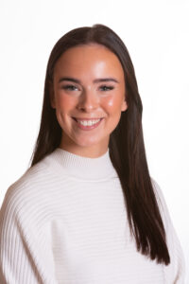
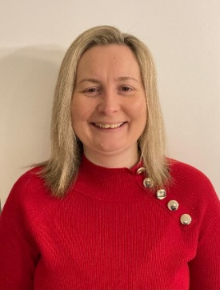
Year 2 Staff
Class Teachers
Miss Agutter & Mrs Birbeck
Mon & Tues Wed,Thurs & Fri

Slide 3
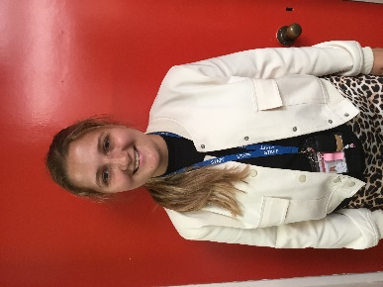
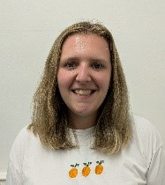
Classroom Teaching Assistant: Miss Jackson
PPA cover Teacher: Mrs Bartlett

Slide 4
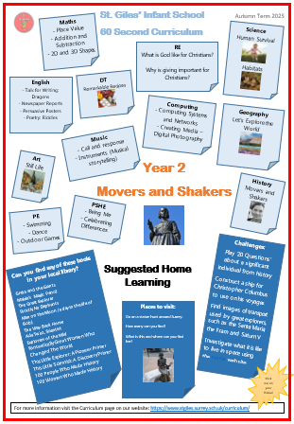
60 Second Curriculum Map

Slide 5




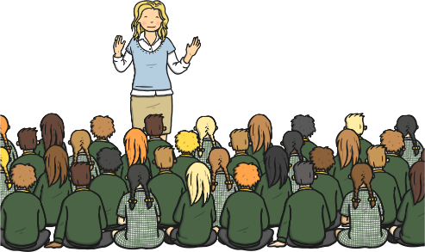
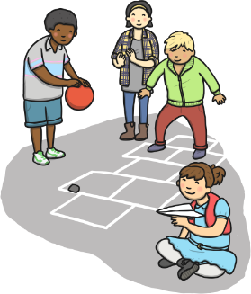
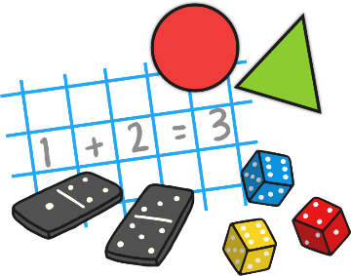
A Typical Day in Rabbit Class
Morning…..
Register Guided Reading Phonics/Spelling
English Assembly
Break Time Maths

Slide 6
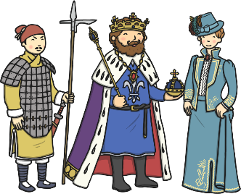
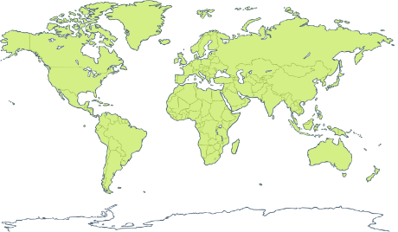




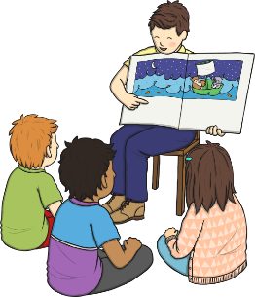

Afternoon
History or Geography Science P.E.
Art R.E.
End the day with a story/class book.

Slide 7
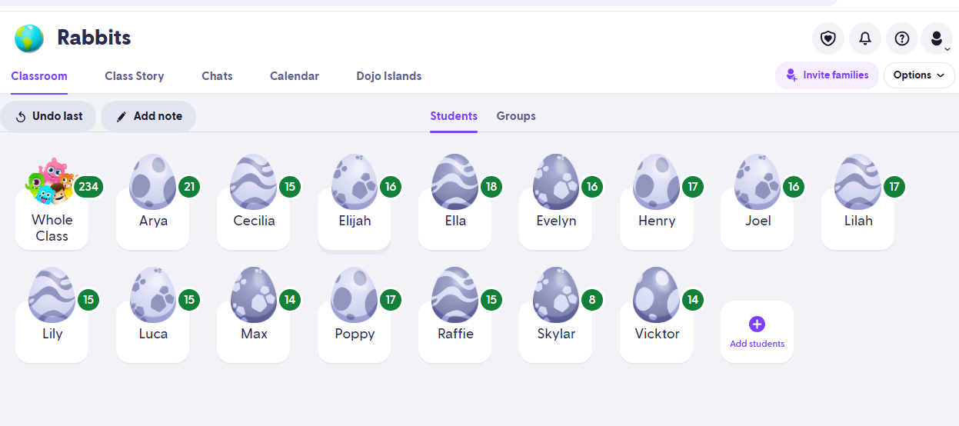
Dojo Points

Slide 8

P.E.
Thursday afternoon (one session).
Swimming is normally on a Tuesday morning in the Autumn Term but this
is TBC.
During Spring and Summer term second P.E. session during the week (day will be confirmed before start of Spring term).

Slide 9

Phonics
Little Wandle Scheme.
25 minutes everyday with the whole class.
Currently revising Phase 5.

Slide 10
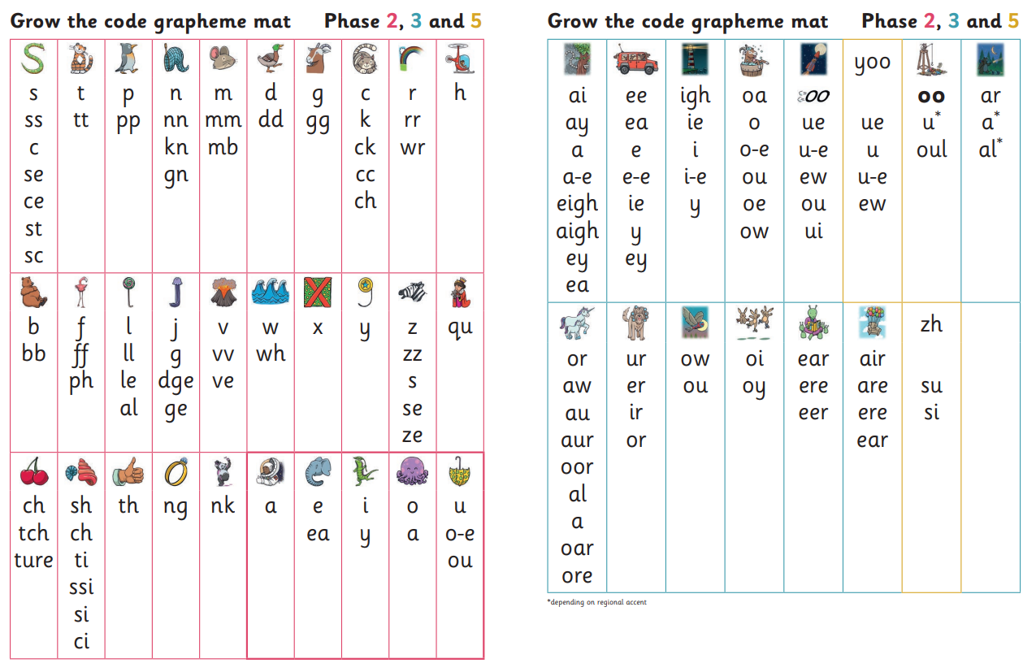
Phase 5

Slide 11

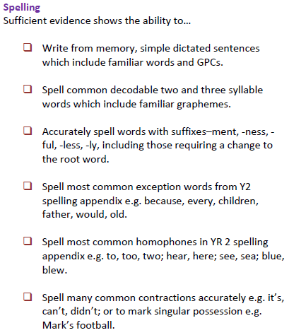
Spelling
Little Wandle Spelling Programme.
25 minutes everyday with the whole class.
Will begin in Autumn 2.

Slide 12


pink | red | yellow | blue | green | orange | turquoise | purple | gold | white | lime
Read the Rainbow
Reading:
Guided Reading 3 x weekly.
New Reading Records.
Children have been given colour banded books (as in Year 1). According to their phonic knowledge.
New Reading Rainbow- Free Reader.
Reading books can be changed daily
Where possible children should read
every day at home!

Slide 13
Homework
Project linked to History/Geography Topic (Half termly/termly).
Where possible children should read every day at home!

Slide 14
History/Geography Home Learning Projects
Autumn 1 – Movers and Shakers
Autumn 2 – Explore the World
Spring Term – Magnificent Monarchs
Summer Term – Coastlines

Slide 15


History/Geography Home Learning Projects

Slide 16
End of Key Stage 1 Assessments
Teacher assessment
Children will be…
Working towards the Expected Standard
Working at the Expected Standard
Working above the Expected Standard (Greater Depth)

Slide 17
End of Key Stage 1 Assessments
All Non-Statutory
Maths – 2 papers.
English – Reading (2 papers).
English – SPaG (2 papers).
May/June 2026

Slide 18
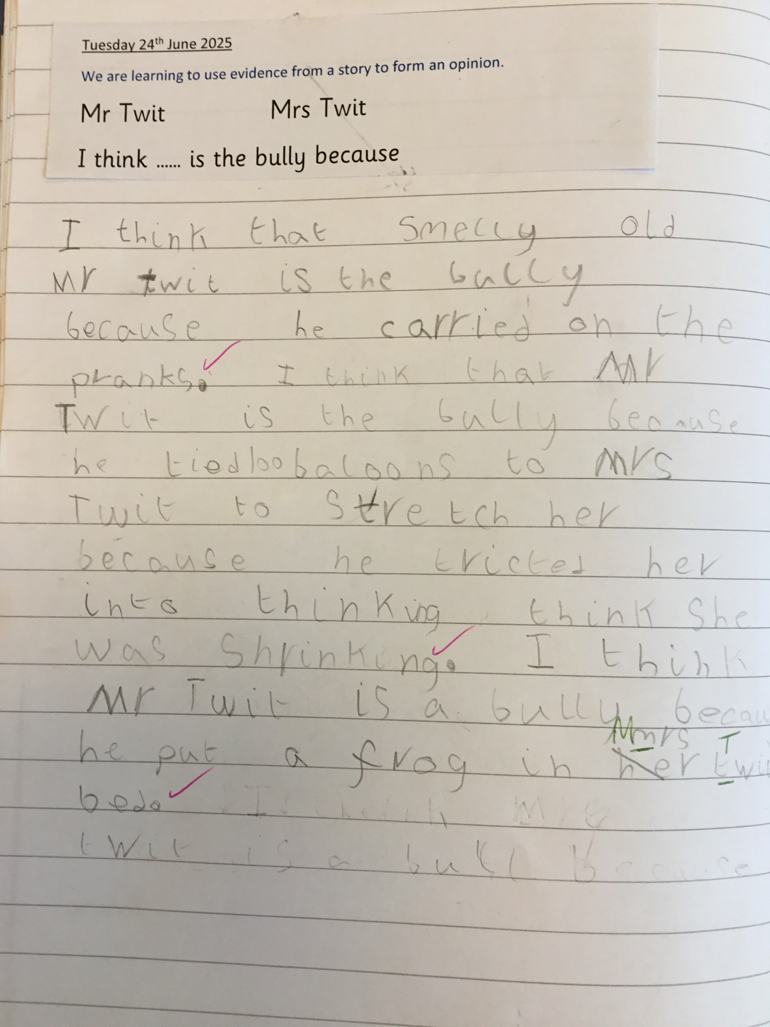
Working at the Expected Standard Writing Example:

Slide 19
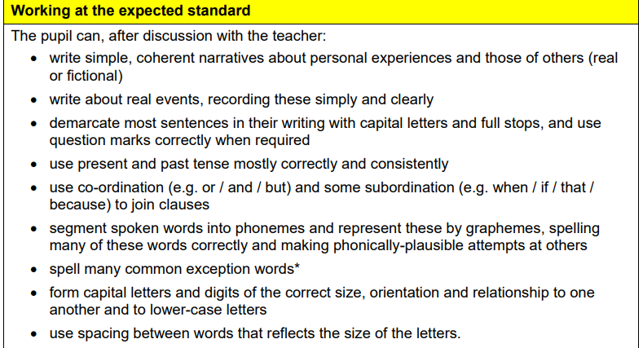
Independence is key!

Slide 20
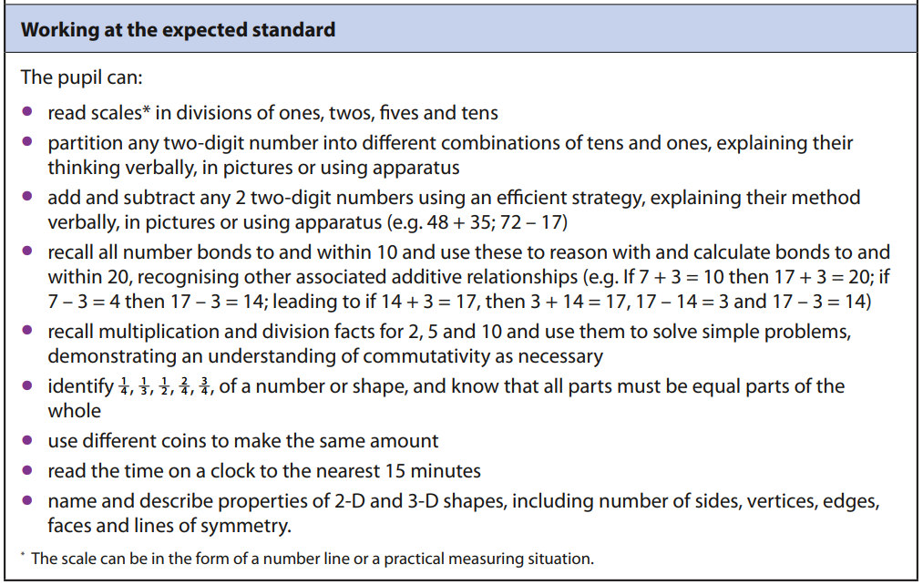
Maths

Slide 21
Whole school information
Please make sure EVERY item of clothing is named.
Named water bottles please.
Reading books can be changed daily – please remind your child if they need to change their book.

Slide 22
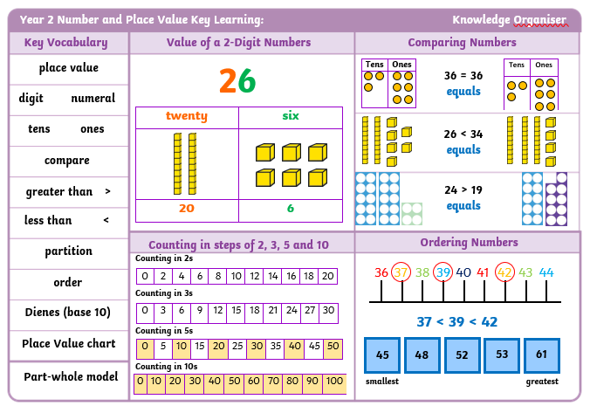
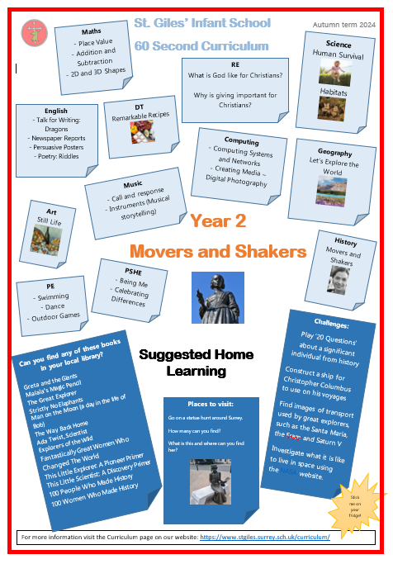
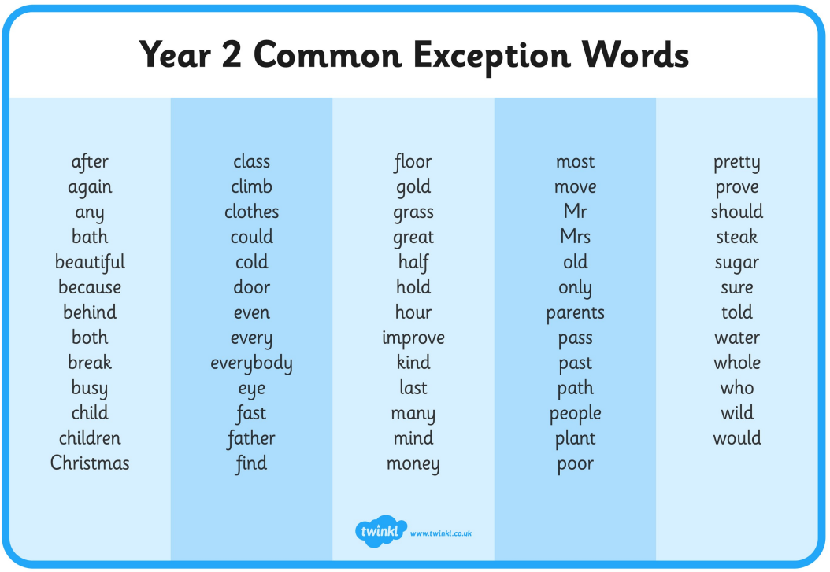
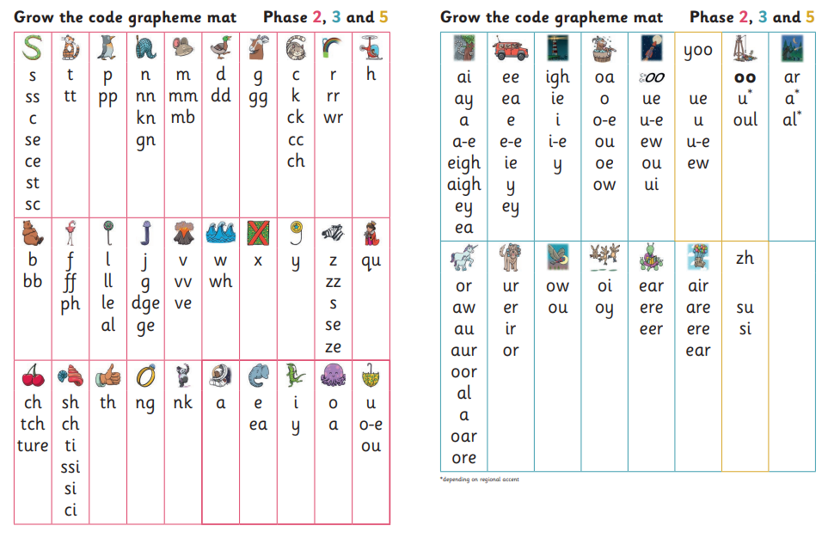
Handouts: Please help yourself!

Slide 23
Rabbits@stgiles.surrey.sch.uk
Any questions?
Please feel free to stay behind and ask!

