Slide 1
RSE at St. Giles' C of E (A) Infant School Parent Workshop May 2023

Slide 2
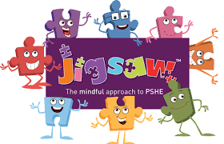
Agenda
 | What is RSE?
 | How do we teach RSE at St. Giles'?
 | Church school perspective – how do our values feed in to RSE?
 | Our school aims and vision
 | Jigsaw
 | Thrive
 | FAQs
 | Policies
 | Useful information and links
1
2
3
4
5
6
7
8
9

Slide 3
Relationships and Sex Education
“Today’s children and young people are growing up in an increasingly complex world and living their lives seamlessly on and offline. This presents many positive and exciting opportunities, but also challenges and risks. In this environment, children and young people need to know how to be safe and healthy, and how to manage their academic, personal and social lives in a positive way.”
(DfE 2019, Relationships Education, Relationships and Sex Education and Health Education)
Link to DfE Guidance Document

Slide 4
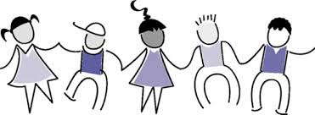
Relationships and Sex Education (cont.)
Relationships education supports our safeguarding agenda and is compulsory
It involves discussing feelings, healthy relationships, friendships, what’s OK and what’s not OK
At primary level the curriculum is based around the experience of the child in the context of their family
Parents will have the right to request that their child is withdrawn from sex education as part of RSE (but not from sex education within the national science curriculum)

Slide 5
OFSTED Reference
‘Pupils can explain accurately and confidently how to keep themselves healthy. They make informed choices about healthy eating, fitness and their emotional and mental well-being. They have an age-appropriate understanding of healthy relationships and are confident in staying safe from abuse and exploitation.’
Outstanding criteria from new framework 2019
Keeping Children Safe
Ofsted inspectors will always have regard for how well children and learners are helped and protected so that they are kept safe.
Inspectors will also look at the safeguarding in a school when determining overall grade. Effective RSE it pivotal to this.

Slide 6
Policy for RSE
All maintained schools are required to have an up to date Relationships and Sex Education (RSE) policy that describes the content and organisation of RSE where it is taught outside the Science curriculum. All schools are required to have this information available on their school website.
https://www.stgiles.surrey.sch.uk/wp-content/uploads/2021/09/Relationship-and-Sex-Education.pdf
The rationale of our RSE policy is:
To provide a secure, sensitive and caring framework where learning and discussion can take place.
To provide information which is easy to understand, relevant and appropriate for the needs, age and maturity of the pupils.
To encourage the use of correct vocabulary.
To foster self-worth and awareness, together with a sense of moral responsibility.
To help the children to acquire and practice important life skills such as critical thinking, decision making, communication and assertiveness.
To ensure that relationship education is available to all children regardless of gender, ability, cultural or religious background in line with the schools policy on equal opportunities.

Slide 7
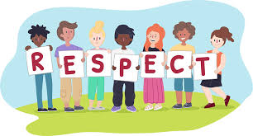
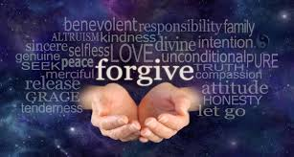
Our School Vision and Values
"Loving God and loving our neighbour"
Love
Compassion
Respect
Forgiveness
Friendship
Courage
Thankfulness

Slide 8
British Values and RSE

Slide 9
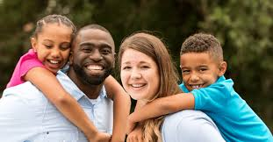
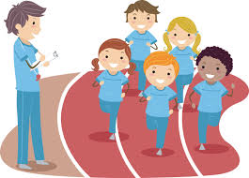
Compulsory Curriculum
Content for Primary aged children - by the end of Key Stage 2 (Year 6) pupils should know...
Relationships Education
Families and people who care for me
Caring Friendships
Respectful Relationships
Online Relationships
Being safe
Health Education
Healthy Eating
Drugs, alcohol and tobacco
Health and prevention
Basic first aid
Physical health and fitness
Mental wellbeing
Internet safety and harms
Changing adolescent body

Slide 10
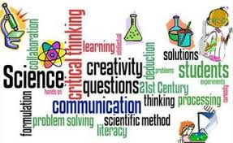
Our Science Curriculum
Early Years Foundation Stage
‘Understanding the World’ part of the EYFS framework. Children will investigate, question and explore – ‘an inquiring mind’.
Year 1
Identify, name, draw and label the basic parts of the human body and say which part of the body is associated with each sense.
Year 2
Notice that animals, including humans, have offspring which grow into adults.
Find out about and describe the basic needs of animals, including humans, for survival (water, food and air).
Describe the importance for humans of exercise, eating the right amounts of different types of food, and hygiene.

Slide 11
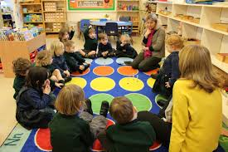
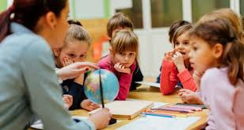
How do we teach RSE at St. Giles'?
"My commandment is this: love one another, just as I have loved you" - John 15:12
The central message of the Christian faith is love. The central message of our RSE teaching is love.
Everything we do at our school is underpinned by our Christian Vision and Values:
Personal, Social and Health Education (PSHE) lessons
Parts of the Science curriculum feed into RSE
Circle times / Assemblies / Stories
Jigsaw programme
Thrive approach and intervention programme
During play

Slide 12
Jigsaw
The Jigsaw PSHE Programme includes lessons on ALL aspects of compulsory Relationships and Health Education, designed in a sensitive, spiral, age-appropriate curriculum.
Jigsaw PSHE is a comprehensive and completely original Scheme of Work (lesson plans) for the whole primary school. The Jigsaw teaching materials integrate Personal, Social, Health Education (PSHE), emotional literacy, social skills, mindfulness, and spiritual development in a whole-school approach. The expectations of the DfE Relationships and Health Education guidance are woven throughout Jigsaw but specifically covered in the Relationships and Healthy Me Puzzles (units), with puberty and human reproduction being taught in the Changing Me Puzzle.

Slide 13
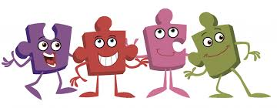
Jigsaw (cont.)
The Jigsaw PSHE lessons aim to give children their entitlement to information about relationships, puberty and human reproduction, appropriate to their ages and stages of development. This work is treated in a matter-of-fact and sensitive manner and helps children to cope with change, including puberty, and to learn about healthy relationships.

Slide 14
Jigsaw (cont.)
There are six Puzzles (units):
Being me in My World
Celebrating Difference
Dreams and Goals
Healthy Me
Relationships
Changing Me
Each unit has six lessons.
These are sequenced from the beginning to the end of the school year. The Relationships and Changing Me Puzzles are taught in the Summer Term.

Slide 15
Jigsaw in EYFS
Unit | Learning intentions
Being Me in My World | I understand how it feels to belong and that we are similar and different I can start to recognise and manage my feelings I enjoy working with others to make school a good place to be I understand why it is good to be kind and use gentle hands I am starting to understand children’s rights and this means we should all be allowed to learn and play I am learning what being responsible means
Celebrating Difference | I can identify something I am good at and understand everyone is good at different things I understand that being different makes us all special I know we are all different but the same in some ways I can tell you why I think my home is special to me I can tell you how to be a kind friend I know which words to use to stand up for myself when someone says or does something unkind
Dreams and Goals | I understand that if I persevere I can tackle challenges I can tell you about a time I didn’t give up until I achieved my goal I can set a goal and work towards it I can use kind words to encourage people I understand the link between what I learn now and the job I might like to do when I’m older I can say how I feel when I achieve a goal and know what it means to feel proud
Unit | Learning intentions
Healthy Me | I understand that I need to exercise to keep my body healthy I understand how moving and resting are good for my body I know which foods are healthy and not so healthy and can make healthy eating choices I know how to help myself go to sleep and understand why sleep is good for me I can wash my hands thoroughly and understand why this is important especially before I eat and after I go to the toilet I know what a stranger is and how to stay safe if a stranger approaches me
Relationships | I can identify some of the jobs I do in my family and how I feel like I belong I know how to make friends to stop myself from feeling lonely I can think of ways to solve problems and stay friends I am starting to understand the impact of unkind words I can use Calm Me time to manage my feelings I know how to be a good friend
Changing Me | I can name parts of the body I can tell you some things I can do and foods I can eat to be healthy I understand that we all grow from babies to adults I can express how I feel about moving to Year 1 I can talk about my worries and/or the things I am looking forward to about being in Year 1 I can share my memories of the best bits of this year in Reception

Slide 16
Jigsaw in Key Stage One
Unit | Year 1 | Year 2
Being Me in My World (Recovery Package 2020) | I can explain why my class is a happy and safe place to learn. I can give different examples where I or others make my class happy and safe. | I can explain why my behaviour can impact on other people in my class. I can compare my own and my friends’ choices and can express why some choices are better than others.
Celebrating Difference | I can tell you some ways that I am different and similar to other people in my class, and why this makes us all special. I can explain what bullying is and how being bullied might make somebody feel. | I can explain that sometimes people get bullied because they are seen to be different. This might include people who do not conform to gender stereotypes. I can explain how it feels to have a friend and be a friend. I can also explain why it is ok to be different from my friends.
Dreams and Goals | I can explain how I feel when I am successful and how this can be celebrated positively. I can say why my internal treasure chest is an important place to store positive feelings | I can explain how I played my part in a group and the parts other people played to create an end product. I can explain how our skills complimented each other. I can explain how it felt to be part of a group and can identify a range of feelings about group work.
Healthy Me | I can explain why I think my body is amazing and can identify a range of ways to keep it safe and healthy. I can give examples where being healthy can help me feel happy | I can explain why foods and medicines are good for my body comparing my ideas with less healthy/ unsafe choices. I can compare my own and my friends’ choices and can express how it feels to make healthy and safe choices.
Relationships | I can explain why I have special relationships with some people and how these relationships help me feel safe and good about myself. I can also explain how my qualities help these relationships. I can give examples of behaviour in other people that I appreciate and behaviours that I don’t like. | I can explain why some things might make me feel uncomfortable in a relationship and compare this with relationships that make me feel safe and special. I can give examples of some different problem-solving techniques and explain how I might use them in certain situations in my relationships.
Changing Me | I can compare how I am now to when I was a baby and explain some of the changes that will happen to me as I get older. I can use the correct names for penis, testicles, anus, vagina, vulva, and give reasons why they are private. I can explain why some changes I might experience might feel better than others. | I can use the correct terms to describe penis, testicles, anus, vagina, vulva and explain why they are private. I can explain why some types of touches feel OK and others don’t. I can tell you what I like and don’t like about being a boy/girl and getting older, and recognise that other people might feel differently to me.

Slide 17
Puberty and Reproduction
What will my child be taught?
Ages 3-5 Growing up: how we have changed since we were babies
Ages 5-6 Boys’ and girls’ bodies; correct names for body parts
Ages 6-7 Boys’ and girls’ bodies; body parts and respecting privacy (which parts of the body are private and why this is)

Slide 18
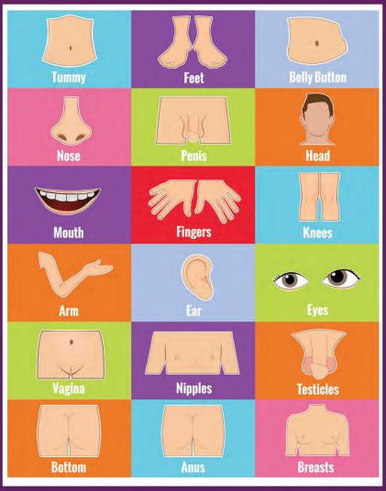
Year 1 – Changing Me: Lesson 4
What will my child be taught?
To identify the parts of the body that make boys different to girls and use the correct names for these: penis, testicles, vagina
To respect my body and understand which parts are private

Slide 19
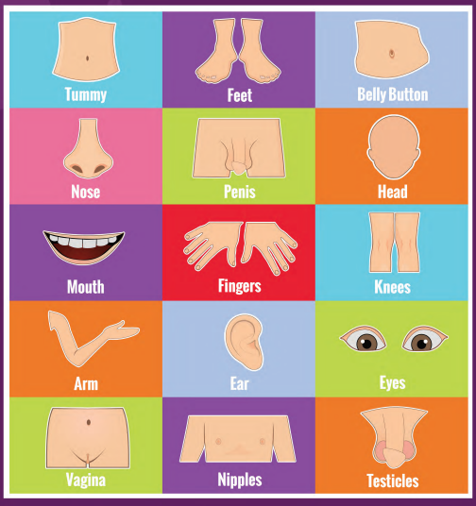
Year 2 – Changing Me: Lesson 4
What will my child be taught?
To recognise the physical differences between boys and girls, use the correct names for parts of the body (penis, testicles, vagina) and appreciate that some parts of my body are private
To say what I like/don’t like about being a boy/girl

Slide 20
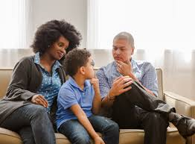
Talking to your Children
How can I talk to my child about relationships, puberty and human reproduction?
What children learn at school is only part of the curriculum, and children can continue to learn from you at home. For some parents/carers, it can feel totally natural to discuss relationships, puberty and human reproduction with their child, while for others it can seem uncomfortable.

Slide 21
Talking to your Children (cont.)
• We all want children to be safe, healthy and happy.
• We need to consider their needs and the world they inhabit.
• We need to normalise talking about relationships, puberty and human reproduction to ensure children feel they can talk to parents/carers about any concerns or worries they may have.
• We may need to challenge our own ways of thinking about how we feel about relationships and sex education.
• We have choices. We can avoid talking about relationships and puberty or we can communicate openly and honestly with children.

Slide 22
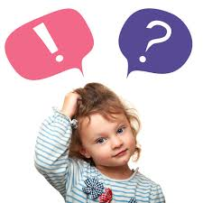
Tips for talking to your Children
• Be honest. If you don’t know the answer to a question, be honest and say so. Tell your child that you will need to find out and that you will get back to them with more soon.
• Remember that children are curious and want to know and understand. We tend to place our adult perspective on children’s questions and comments, when actually a child just wants (and needs) a very simple, age-appropriate, matter-of-fact answer.
This answer will not involve an ‘adult’ understanding of a topic – it needs to be at a child’s level, with opportunity given for the child to be able to ask further questions if needed. Give yourself time to respond by asking something like, “What do you think that means?” or “Why do you ask?”

Slide 23
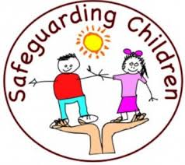
Tips for talking to your Children (cont.)
Keep lines of communication open. Having an open and honest relationship with your child can really help make conversations easier, so make sure that you are always willing to talk when your child needs you; if you can’t, explain why and find another time when it is more mutually convenient.
• Use correct terminology. It helps that children aren’t confused by hints, euphemisms and innuendo; use correct terminology whenever you can, especially for body parts.
This is hugely important for safeguarding too.

Slide 24
Tips for talking to your Children (cont.)
• Respond to what children say they need. Bear in mind that children’s lives today are very different from even five years ago. Therefore, the education they receive needs to reflect this. Research shows us that children want and need to understand relationships, puberty and human reproduction, and want to be able to talk with parents/carers about this when they have had lessons at school. We may feel that
they know too much, when actually ignorance is the enemy of innocence.
• Answer questions and don’t be afraid to say, ‘I really don’t know – let’s work it out or look it up together’. Have a phrase for awkward moments, such as, ‘That’s a good question, and let’s talk about it once we get home’.
• Always respond. If you don’t, they may think it is wrong to talk to you about relationships, puberty or human reproduction and as a result you may find your child clams up when you want to raise the subject, now or in the future.
• If it all feels too personal, try talking about people in books, films and favourite television programmes.
• Enjoy it. Laugh with each other!
• Work in partnership with the school.
Copyright Jigsaw PSHE Ltd 2020

Slide 25
Frequently Asked Questions
Question:
Will my child be taught sex education at primary? This is too young.
Answer:
The Department for Education are not introducing compulsory sex education at primary school.
They are introducing Relationships Education at primary, to put in place the building blocks needed for positive and safe relationships of all kinds. This will start with family and friends, how to treat each other with kindness, and recognising the difference between online and offline friendships.
Many primary schools choose to teach sex education (which goes beyond the existing national curriculum for science), and they recommend that they do so, tailored to the age, physical and emotional maturity of their pupils. In those instances they recommend you discuss this with the school, to understand what they propose to teach and how. If you continue to have concerns, you have an automatic right to withdraw your child from these sex education lessons.

Slide 26
Frequently Asked Questions (cont.)
Question:
Does the new Relationships Education and RSE curriculum take account of my faith?
Answer:
The subjects are designed to help children from all backgrounds build positive and safe relationships, and to thrive in modern Britain.
In all schools, when teaching these subjects, the religious background of pupils must be taken into account when planning teaching, so that topics are appropriately handled. Schools with a religious character can build on the core required content by reflecting their beliefs in their teaching.
In developing these subjects, the Department for Education have worked with a number of representative bodies and faith organisations, representing all the major faith groups in England. Several faith organisations produce teaching materials that schools can choose to use.

Slide 27
Frequently Asked Questions (cont.)
Question:
Do I have a right to withdraw my child from Relationships and Sex Education?
Answer:
Parents will continue to have a right to request to withdraw their child from sex education delivered as part of RSE in secondary schools which, unless there are exceptional circumstances, should be granted up to three terms before their child turns 16. At this point, if the child themselves wishes to receive sex education rather than be withdrawn, the school should make arrangements for this to happen in one of the three terms before the child turns 16 - the legal age of sexual consent.
There is no right to withdraw from Relationships Education at primary or secondary as we believe the contents of these subjects – such as family, friendship, safety (including online safety) – are important for all children to be taught.

Slide 28
Frequently Asked Questions (cont.)
Question:
Will my child be taught about LGBT relationships?
Answer:
Pupils should be taught about the society in which they are growing up. These subjects are designed to foster respect for others and for difference, and educate pupils about healthy relationships.
Pupils should receive teaching on LGBT content during their school years. Teaching children about the society that we live in and the different types of loving, healthy relationships that exist can be done in a way that respects everyone. Primary schools are strongly encouraged and enabled to cover LGBT content when teaching about different types of families.

Slide 29
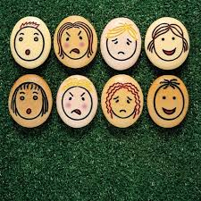
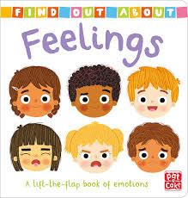
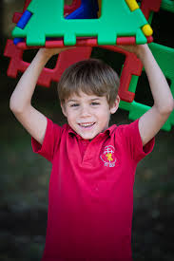
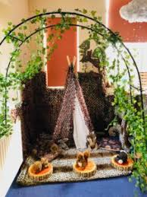
Thrive in our School

Slide 30
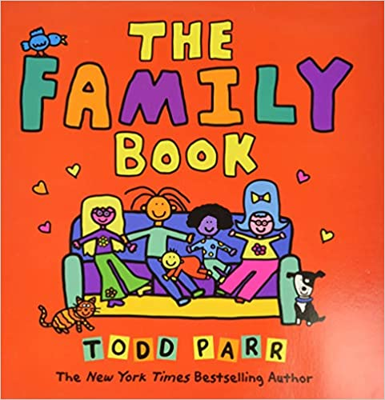
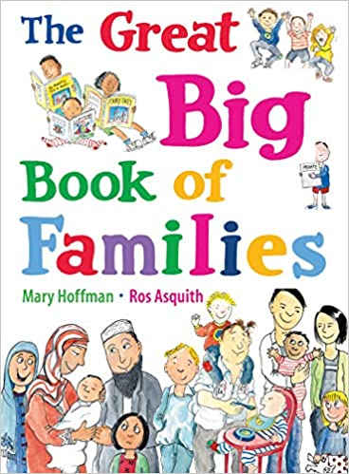
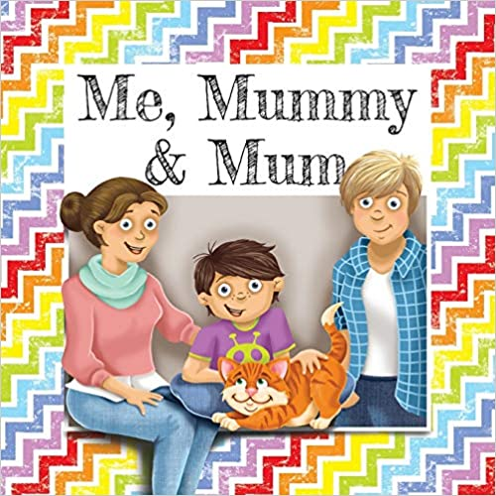
Some of the Texts Used in School
The Huge Bag of Worries | Virginia Ironside
Bill's New Frock | Anne Fine
Poor Monty | Anne Fine
Who's in a Family? | Robert Skutch
Something Special | Nicola Moon
Hugless Douglas | David Melling
Poem: I have a secret | E.J. Thornton
Don’t tell lies Lucy! | Phil Roxbee-Cox
My Grandpa is amazing | Nick Butterworth
Titch | Pat Hutchins
Hug | Jez Alborough

Slide 32
Useful Information and Links
Relationships, sex and health education: guides for parents:
https://assets.publishing.service.gov.uk/government/uploads/system/uploads/attachment_data/file/907638/RSE_primary_schools_gu
Government Policy paper: Relationships education, RSE and PSHE
https://assets.publishing.service.gov.uk/government/uploads/system/uploads/attachment_data/file/595828/170301_Policy_statement_PSHEv2.pdfide_for_parents.pdf

