Slide 1
E-Safety
HELPING TO KEEP YOUR CHILDREN SAFE ONLINE
ST GILES’ C OF E (A) INFANT SCHOOL

Slide 2
Aims
E-safety in the Computing Curriculum
Reflect on the potential risks of internet use for children
Be aware of the importance of communication with children about the time they spend online
Understand how to find out about setting up parental controls on home and mobile devices
Know what to do if your child encounters problems online

Slide 3
Statistics
One in three children are internet users
Almost one in four of 8-11 year olds and three in four 12-15 year olds has a social media profiles
One in four children has experienced something upsetting on a social networking site
One in eight children have been bullied on social media

Slide 4
Age Restrictions
The minimum age for a Facebook account is 13
The minimum age for an Instagram account is 13
The minimum age to play ‘Fortnite’ is 12
https://www.sporcle.com/games/BoggelTeam/doubletap
https://kidshealth.org/en/parents/social-media-smarts.html

Slide 5
E-Safety in the National Curriculum
Within the Digital Literacy strand of the Computing Curriculum, by the end of Key Stage 1 pupils should be able to:
Use technology safely and respectfully, keeping personal information private
Identify where to go for help and support when they have concerns about content or contact on the internet or other online technologies

Slide 6
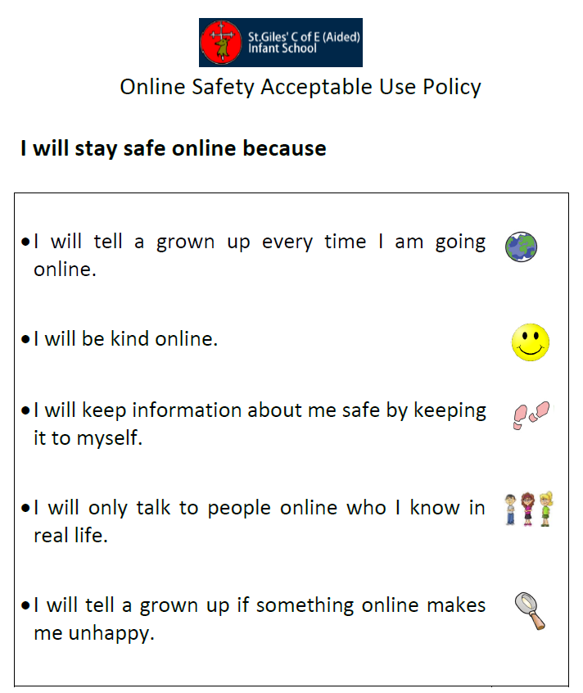
E-Safety at St. Giles’
All children have signed our child friendly
Acceptable Use Policy.
We discuss e-safety regularly as part of our
Computing lessons and teach a stand alone
e-safety lesson every term.
We use stories such as the Digiduck series to
Teach internet safety issues in an age appropriate way
https://www.childnet.com/resources/digiduck-stories/

Slide 7
Children Online: Potential Risks
Contact: children can be contacted by bullies or people who groom or seek to abuse them
Content: age-inappropriate or unreliable content can be available to children
Conduct: children may be at risk because of their own behaviour, for example, by sharing too much information
Commercialism: young people can be unaware of hidden costs and advertising in apps, games and websites
Cyber bullying
Grooming
Access to inappropriate websites (via pop-ups)
Losing control over pictures and video / Giving out too much information online
Viruses, hacking and security

Slide 8
Hidden Risks of Gaming
Many online games have communication features which allow their users to interact anonymously e.g. Minecraft (all devices) and World of Warcraft (PC).
Cyberbullies may harass fellow gamers and online scam artists may promise virtual goods in an effort to get credit card information e.g. World of Warcraft.
Some game consoles allow internet access as well, so it is important to be aware of their communication features.
https://www.askaboutgames.com/
https://www.nspcc.org.uk/preventing-abuse/keepingchildren-safe/onlinesafety/online-gamingstay-safe-avoid-risks/
https://www.nspcc.org.uk/keeping-children-safe/online-safety/online-games/

Slide 9
Tips for Parents
Keep the computer in a high-traffic area of your home.
Establish limits for which online sites children may visit and for how long.
Remember that Internet technology can be mobile, so make sure to monitor mobile phones, gaming devices, and laptops.
Surf the Internet with your children and let them show you what they like to do online.
Know who is connecting with your children online and set rules for social networking, instant messaging, e-mailing, online gaming, and using webcams.
Check the browser search history on a regular basis.

Slide 10
Communication is Key
Be a part of their online life; involve the whole family and show an interest. Find out what sites they visit and what they love about them.
No filter or parental controls tool is 100% effective, and many of the risks that children face online are because of their own and other’s behaviour.
Create a family agreement for internet use, such as on:
https://www.childnet.com/resources/family-agreement/
Use the NSPCC and LEGO ‘Build and Talk’ activities
https://www.lego.com/en-gb/sustainability/children/buildandtalk/?locale=en-gb

Slide 11
Conversation Starters
What are your favourite things to do online?
What is personal information? Why should you keep it private?
What could you do to be safer online?
What would you do if anyone online asked to meet you face-to-face?
Besides me, who do you feel that you can talk to if you are in a scary or uncomfortable situation?
How many people do you have on your buddy/contact list(s) and who are they?
Have you ever chatted with someone you did not know in real life? What kinds of things did you talk about?
Do you know how to block others in chat rooms and Instant Messenger? Can you show me how to do this?
Go to http://www.netsmartz.org/InternetSafety for further examples.

Slide 12
What to do if your child sees inappropriate material online
Don’t overreact if your child tells you about something they have seen. You might feel shocked and angry but by dealing with it calmly your child will know they can turn to you again.
ALWAYS keep records of abusive messaging.
Report abusive or inappropriate behaviour to the website and if serious, to the police. Keep the school informed too.
If you come across illegal content, such as images of child abuse, you can report this to the Internet Watch Foundation at www.iwf.org.uk

Slide 13
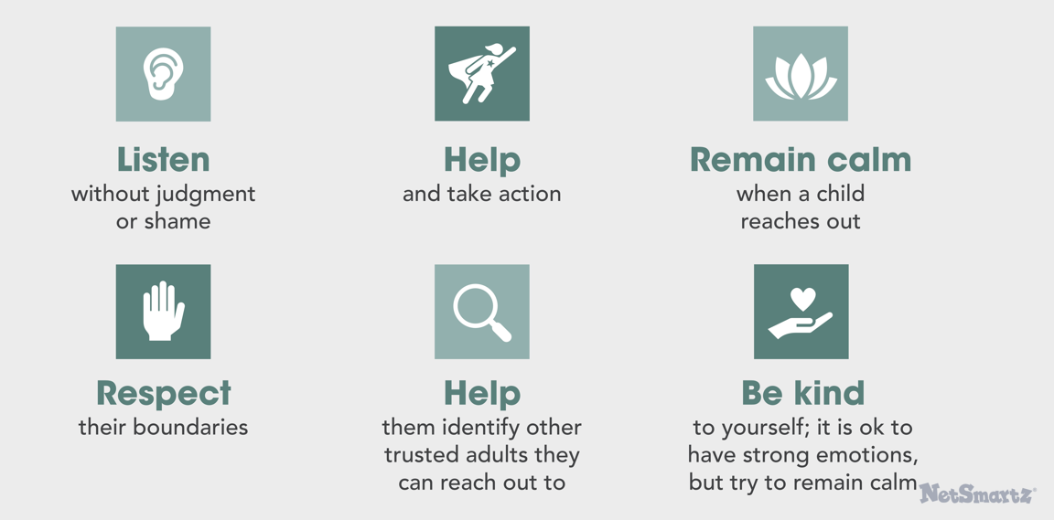
Be a trusted adult

Slide 14
Useful Websites
https://www.thinkuknow.co.uk/parents/
http://www.saferinternet.org.uk/advice-andresources/parents-and-carers
http://www.childnet.com/parents-and-carers
https://www.nspcc.org.uk/preventing-abuse/keeping-childrensafe/online-safety/
http://www.kidsmart.org.uk/parents
http://www.netsmartz.org/Parents

